Slide 1

Internship Report
Intern: Akash Kunwar
Start Date: 20 April’ 2020
End Date:20 May’ 2020
Duration:1 Month

Slide 2
Exposys Data Labs:
Exposys Data Labs aims to Solve real world business problems like Automation, Big Data and data Science. our core team of experts in various technologies help businesses to identify issues,opportunities and prototype solutions using trending technologies like AI, ML, Deep Learning and Data Science. we follow a human-focussed and not technology driven approach to achieve success in our clients endeavours.
Mission: To Tap and train best brainpower to give solutions for real challenges of the world.
Founder and CEO: Y. Vishnuvardhan
Research Scientist: Dr. Aravind Kumar

Slide 3
Objective:
Create Customize Online Store to cater Client’s Needs:
In competitive scenario to grab customer’s attention and conveying unique offerings to them is crucial. Unlike others, designing has been done from the scratch , allowing customers to have full flexibility at end product with unique and engaging look.
Streamlining Online Store for Convenient Usability and Updates:
Design a store that is easy to use and modify with firm’s growth.

Slide 4
Languages and Tools:
HTML
CSS
MongoDB
BootStrap
NodeJS
JavaScript
Express

Slide 5
Description:
The website has been developed for “Sri Chakra Industries” acts as an online portal that facilitate online transactions of goods (i.e. Pressure Cookers) through means of transfer of information and funds.

Slide 6
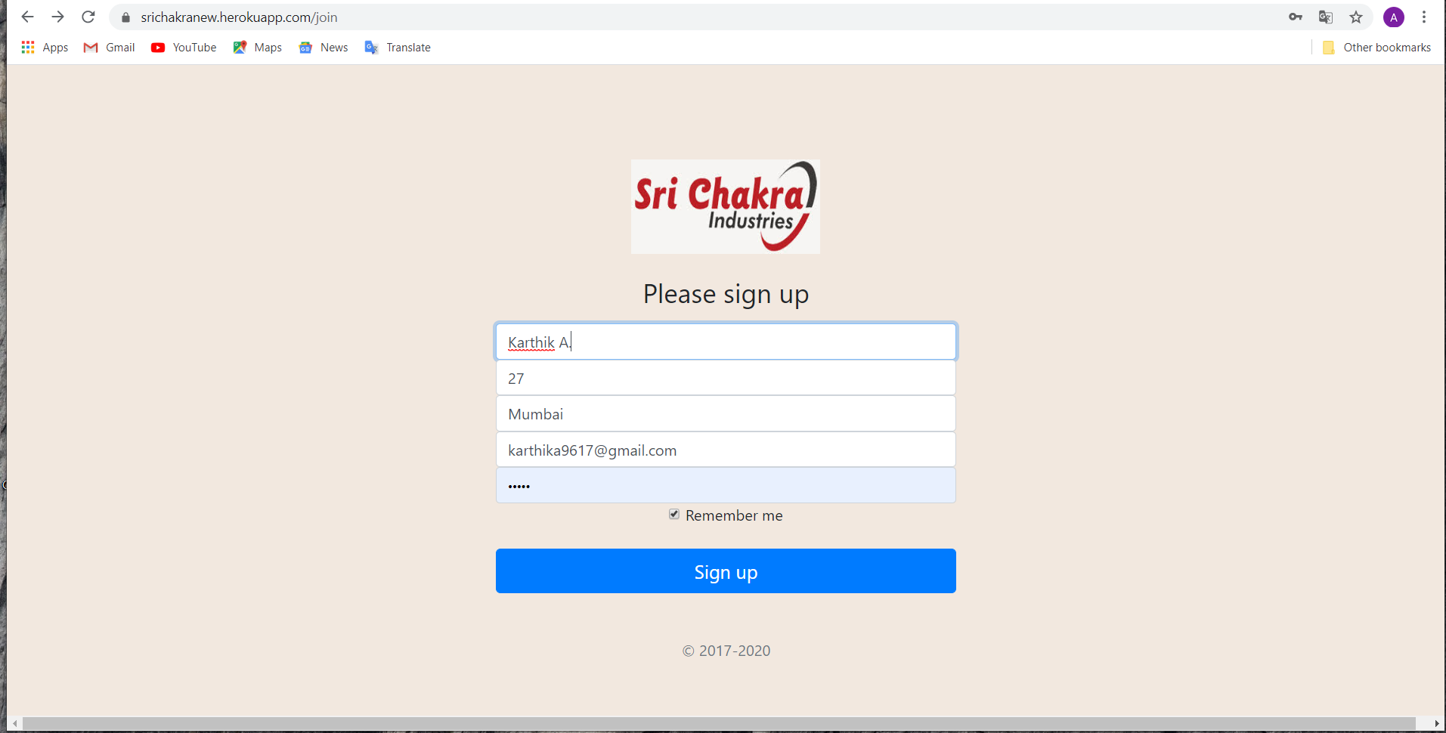
Features:
The website consists of the following features as developed:
Register: Allows a new user to enter one’s general details.

Slide 7
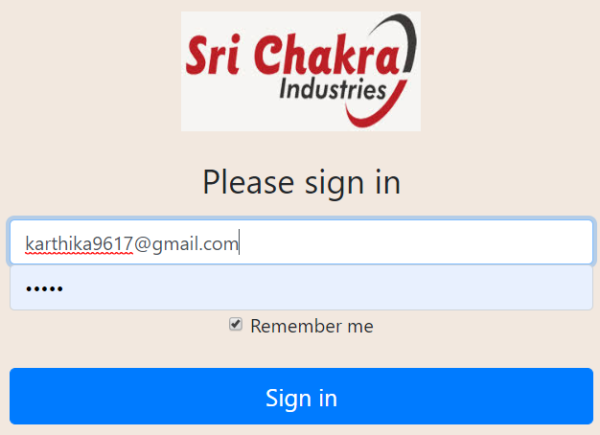
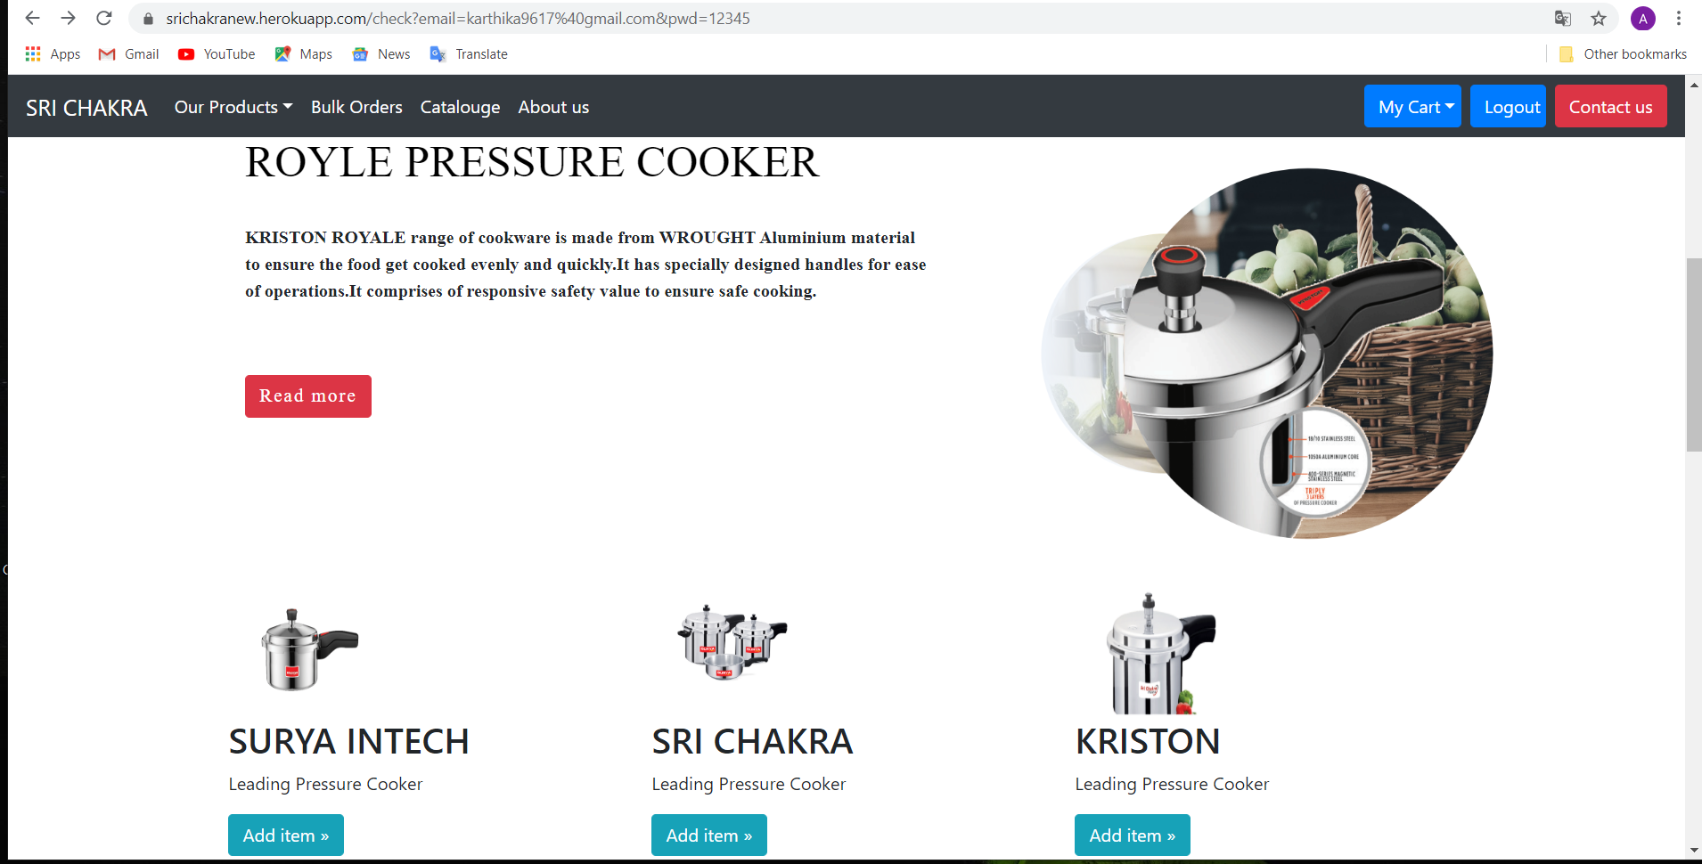
Login: Upon registering, the user can login through one’s credentials.
Catalogue: List of Items to be chose from.

Slide 8
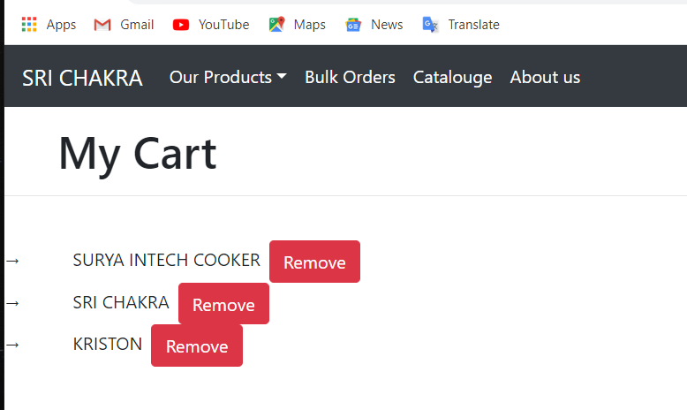
Cart: Consist of Selected Items.
Contact Page: Consist of all the contact related information along with the company’s location.

Slide 9
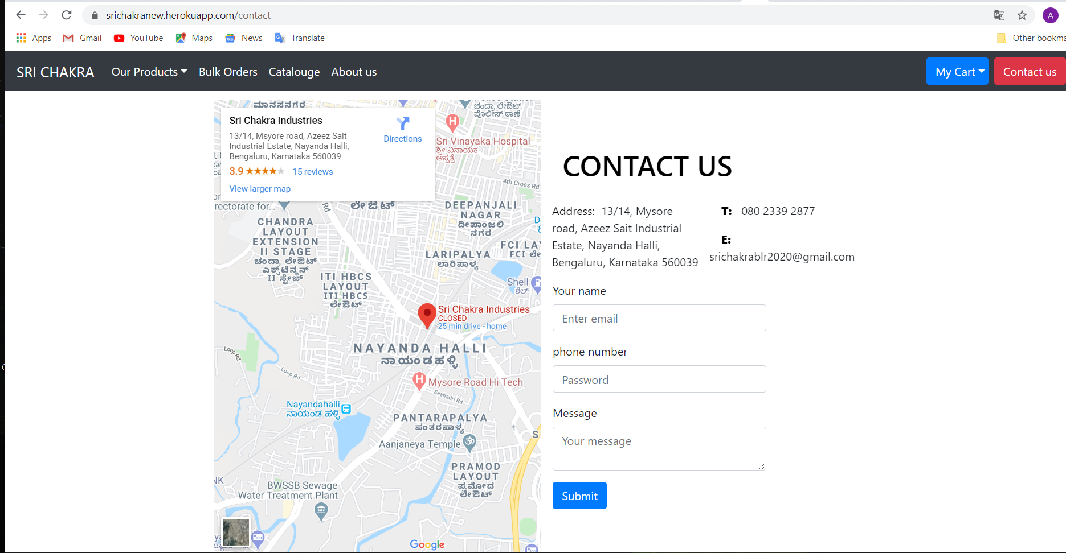

Slide 10
Lessons Learned:
Gain skills and knowledge
Gain experience of working in a professional IT sector
Improve Communication Skills
How to think Professionally
Work in a team and co-ordinate
Think Creatively to generate Ideas

Slide 11
Conclusion:
Using NodeJs to connect front-end and back-end.
CRUD Application creation using NodeJs and MongoDB.
Passport based authentication using NodeJs.
Heroku Cli to deploy website.

Slide 12
THANK YOU

